Slide 1
Meeting Minutes: 14 March 2018
Next Meeting: 22nd March 4:30pm (TBC)
Tasks by next meeting:
Stella
Design mock-ups showing general layout, look & feel for key pages
Wanlu
To compare Google Cloud vs x10host server and check out how to save the data onto the server
Yihan
To develop library of scripts for feedback during the interactive graph stage
Cui Min
To develop library of scripts for orientation, transitions & instructions

Slide 2
Examples of roboadvisories (Look & Feel)

Slide 3
US Robo-Advisory: Betterment
US Robo-Advisory: Personal Capital

Slide 4
US Robo-Advisory: Schwab Intelligent Portfolios

Slide 5
SG Robo-Advisory: Stashaway

Slide 6
SG Robo-Advisory: Smartly

Slide 7
Examples of chatbot interface

Slide 8
Rough mockup for layout
The next 2 slides show roughly where the key elements of the interface (chatboxes, avatar, interactive features) will be. Peripheral elements (e.g. logo, header, footer etc.) can model after existing robo-advisory interface to make our site look legitimate and professional

Slide 9
Rough Mockup
(Orientation stage)
Organisation LOGO, header etc.
Hi there! Welcome to the robo-advisory! I am Michelle, your robo-advisor. I can help you to grow your wealth.
But first, I need some of your information. What is your name?
Sarah
Michelle

Slide 10
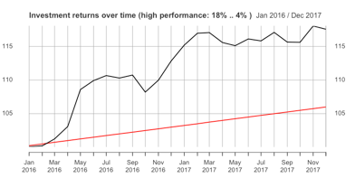
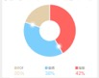
Rough Mockup
(interactive graph stage)
Organisation LOGO, header etc.
Oh no, looks like your annual returns went down again. But remember, don’t make investment decisions based on the short-term.
How do you wish to allocate your capital for the next month?
Performance Summary
Total Return: 10348.93
Robo-Advisor Monthly Gain: -21.8
Bank Deposit Monthly Gain: 12.48
Select your next allocation:
Michelle
Robo-Advisor: 50%
Bank: 50%

Slide 11
Avatar design

Slide 12
Guidelines for designing male & female avatar (for cuimin)
Both Genders
Full body image
Professional-looking
Attire of a bank teller
Same posture, body language, facial expression, level of attractiveness etc.
Race-neutral (e.g. not obviously asian/caucasian/white/black/chinese)
Female
Feminine body shape
Feminine attire (skirt, heels)
Attire of a bank teller
Male
Masculine body shape
Feminine attire (skirt, heels)
Attire of a bank teller

Slide 15
May use this body posture

Slide 16
Guidelines for designing male & female avatar (for cuimin)
Overall appearance
Gender-neutral robot look
Half-length, focusing on facial expression and dress code
Hold other attributes constant
Dominant looking
Dominant posture
Confident expression
Looks like an expert/consultant
Submissive looking
Submissive posture
Reserved expression
Looks like a peer/friend

